Slide 1

Professor August | MGT
Gentle Lentil

Slide 2
Accounting Model of Gentle Lentil’s Monthly Earnings
    What are the monthly fixed costs?
    L = labor costs (random, between $5,040 and $6,860)
    U = rent, utilities, other unavoidable costs, $3,995
    What are the monthly variable costs?
    F = total food costs
    M = number of meals served in month
    F = $11 * M
    What is the monthly total cost?
    L + U + F = L + 3,995 + 11 * M

Slide 3
Gentle Lentil’s Monthly Earnings, continued
    What is the monthly revenue?
    R = monthly revenue, P = price of meal
    R = P * M
    What are the monthly earnings?
    E_{s} = monthly earning = revenue – costs
    = P * M – ( L + 3,995 + 11 * M )
    = (P – 11 ) * M – L – 3,995
    Which of these quantities are random variables?
    P = price of prix fixe meal
M = number of meals sold
L = labor cost
E_{s} = monthly earnings
(E_{s} is a function of random variables, so it is a random variable)

Slide 4
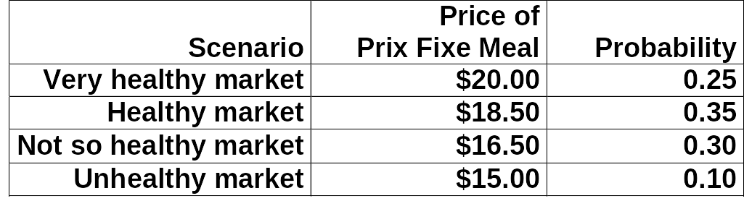
Assumptions Regarding the Random Variables
P = price of the prix fixe meal
We assume that P obeys the following discrete probability distribution.
M = number of meals sold per month
We assume that M obeys a Normal distribution with
μ = 3,000, σ = 1,000.
L = labor cost per month
    We assume that L obeys a uniform distribution with a minimum of $5,040 and maximum of $6,860
Notes:
15.060 Fall 2000

Slide 5
The Behavior of the Random Variables, continued
E_{s} = earnings per month (self scenario)
We do not know the distribution of E_{s}. It depends on P,M, L:
    E_{s} = (P – 11 ) * M – L – 3,995
Notes:
15.060 Fall 2000

Slide 6
What question do we want to ask & answer about
the random variable E?
What is the shape of the probability distribution of E_{s}?
What is E(E_{s}) ? What is SD(E_{s}) ?
What is P(E_{s} ≤ $5,000) ?
What is P(E_{s} ≥ $6,667) ?
Other questions to ask?
And at the end:
What would you do if you were Sanjay?

Slide 7
Simulation of Gentle Lentil Monthly Earnings for “February”
Generate a value of M (number of meals served) from the probability distribution N (3,000, 1,000)
Generate a value of P (price of prix fixe meal) that obeys the given discrete probability distribution
Generate a value of L (labor cost) that obeys the uniform distribution in the range [5,040 , 6,860]
Calculate the monthly earnings E_{s}:
    E_{s} = (P – 11 ) * M – L – 3,995
Run this n times. We used n = 1,000 for illustration purpose
This will generate as output n numbers x₁, x₂, ..., x_{n}.
What shall we do with this output?

Slide 8
What to do with output created by the simulation?
We have as output the n numbers x₁, x₂, ..., x_{n}
Create an estimate of the shape of the underlying probability distribution of E_{s} (earnings).
Create an estimate of the mean μ of E_{s}
Create an estimate of the standard deviation σ of E_{s}
Create an estimate of P(E_{s} ≤ $5,000)
Create an estimate of P(E_{s} ≥ $6,667)

Slide 9
1000 trials of Gentle Lentil monthly simulation
@RISK Data
Performed By: August, Terrence
Date: Monday, November 24, 2014 10:23:18 AM
Name | Earnings for Self Model | L / Random Variable | P / Random Variable | M / Random Variable
Description | Output | RiskUniform(B3,B4) | RiskDiscrete(B5:B8,E5:E8) | RiskNormal(B9,B10)
Iteration / Cell | $H$13 | $H$3 | $H$5 | $H$9
1 | -3737.034037 | 5660.394746 | 18.5 | 789.1147611
2 | 1905.109929 | 6573.950653 | 15 | 3118.515145
3 | 12428.13713 | 6151.037558 | 16.5 | 4104.395398
4 | 11963.15474 | 5531.145978 | 20 | 2387.700079
5 | 14140.64525 | 5675.591344 | 18.5 | 3174.831546
6 | 12138.21859 | 5240.008584 | 16.5 | 3886.041304
7 | 4206.096887 | 6368.381869 | 18.5 | 1942.597167
8 | 9167.263686 | 6006.611798 | 16.5 | 3485.250088
9 | -552.482491 | 5443.004218 | 15 | 2221.380432
10 | 11234.65373 | 5315.165802 | 16.5 | 3735.421734
11 | 19856.77154 | 5885.183578 | 18.5 | 3964.927349
12 | 13158.68761 | 5609.40014 | 16.5 | 4138.743227
13 | 17611.20064 | 6352.595471 | 18.5 | 3727.839482
14 | 7673.172451 | 5252.50441 | 20 | 1880.075207
15 | -4251.086327 | 6778.119805 | 15 | 1630.50837
16 | 10520.48081 | 6103.453216 | 18.5 | 2749.191203
17 | 5861.031853 | 5369.134774 | 15 | 3806.291657
18 | 9972.840483 | 6837.244959 | 18.5 | 2774.011392
19 | 34301.46431 | 6361.715079 | 20 | 4962.019932
20 | 5173.93692 | 5956.977192 | 16.5 | 2750.166202

Slide 10
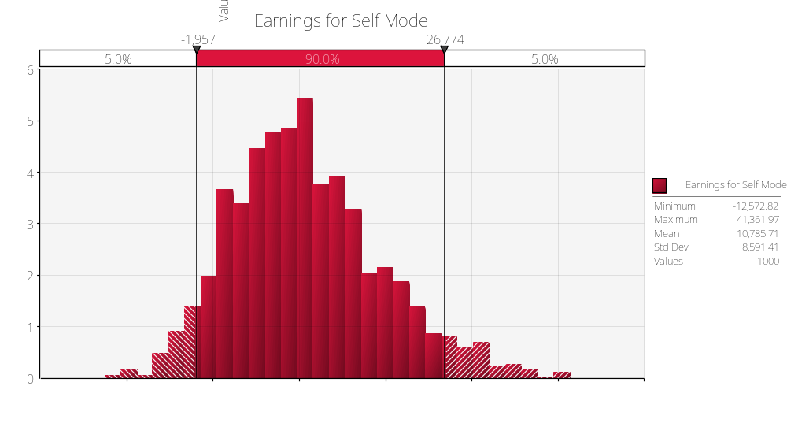
@RISK Output
  Shape of the probability distribution of E_{s}

Slide 11
@RISK Output
  Mean μ of E_{s} & standard deviation σ of E_{s}

Slide 12
@RISK Output
  Mean μ of E_{s} & standard deviation σ of E_{s}
Economics |  |  |  | Probability |  | Random Variable
Non-Labor Costs | 3995 | /month |  | Constant
Labor Costs | 5040 | /month |  | Uniform |  | L | 5950
 | 6860 | /month
Meal Revenue | 20 | /meal |  | 0.25 |  | P | 17.925
 | 18.5 | /meal |  | 0.35
 | 16.5 | /meal |  | 0.3
 | 15 | /meal |  | 0.1
Number Meals | 3000 | /month | (mean) | Normal |  | M | 3000
 | 1000 | /month | (stdev) |  |  |  |  |  | Monthly Results
Unit Meal Cost | 11 | /meal |  | Constant |  |  |  |  | Sim Mean | Sim Stdev
 |  |  |  |  |  | Es | 10830 |  | $10,785.71 | $8,591.41
This spreadsheet was created using Palisade Corporation's CBConverter Utility.

Slide 13
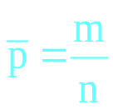

Discussion of Simulation Model Output, continued
A histogram of the trial values x₁, x₂, ..., x_{n} is a good estimate of the shape of the probability distribution of X
Suppose that we want to estimate P(a ≤ X ≤ b) for some given values of a and b
Let m be the number of values in the n observations
x₁, x₂, ..., x_{n} that are in the range between a and b.
Let . Note that is simply the fraction of the observations that are in the range between a and b.
Then is an estimate of the probability P (a ≤ X ≤ b).

Slide 14
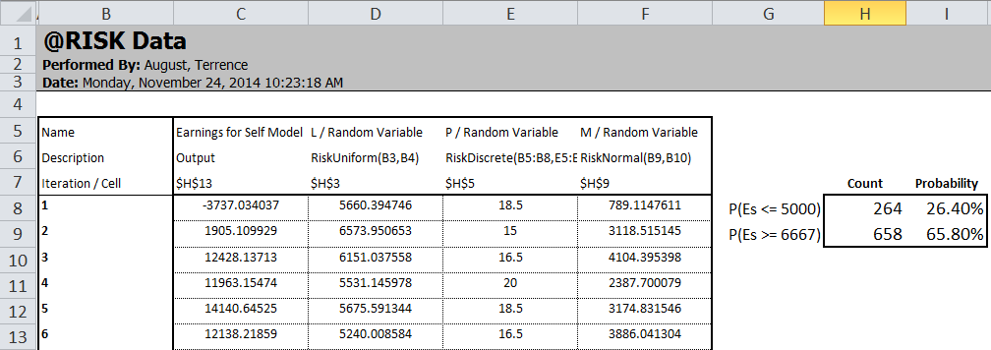
@RISK Output
  Probability that E_{s} will lie in a given range: P( a ≤ X ≤ b) for given values of a and b
=COUNTIF(C8:C1007,"<=5000")
This spreadsheet was created using Palisade Corporation's CBConverter Utility.

Slide 15
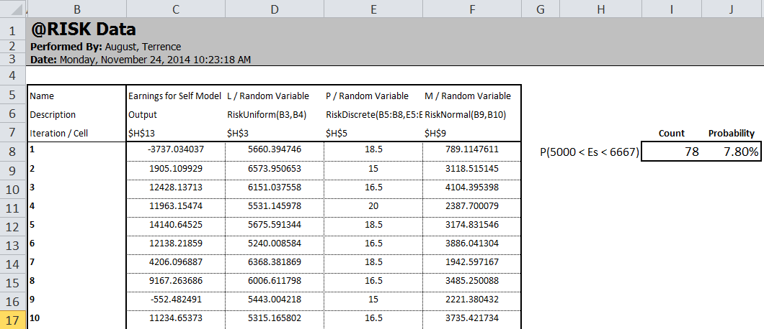
@RISK Output
  Probability that E_{s} will lie in a given range: P( a ≤ X ≤ b) for given values of a and b
=COUNTIFS(C8:C1007,">5000",C8:C1007,"<6667")
This spreadsheet was created using Palisade Corporation's CBConverter Utility.

Slide 16
Simulation of Annual Earnings at Gentle Lentil
Instead of looking just at monthly earnings at Gentle
Lentil, it would be better to look at annual earnings
What should the annual model assume?
All assumptions for the monthly model, plus:
  there are twelve distinct random variables M₁, ... , M₁₂ for the twelve distinct number of meals served in each month
    these random variables will be independent and
    identically distributed (i.i.d.)
  the random variable P (price of prix fixe meal) remains the same over the entire year
  the random variable L (labor cost in month) remains the same over the entire year

Slide 17
Simulation of Annual Earnings at Gentle Lentil, continued.
Generate random values of P , L , and M₁, M₂, ..., M₁₂
according to their respective distributions
Calculate the monthly earnings, for month i:
E_{i,s} =
(P – 11 ) * M_{i} – L – 3,995
for i = 1, ..., 12
A = annual earnings =
E_{1,s} +
E_{2,s} +
. . . +
E_{12,s}
How is this model different from the monthly model?

Slide 18
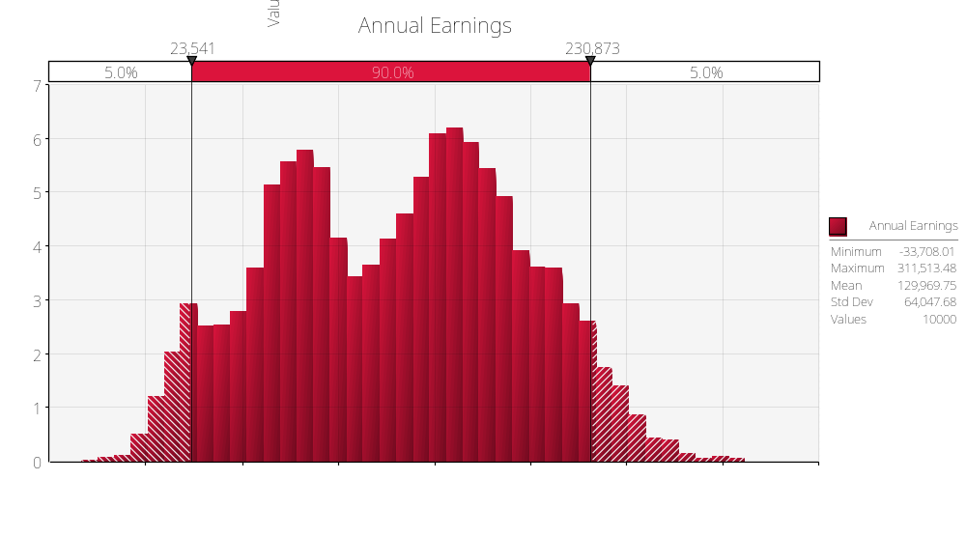
@RISK Output
  Annual Earnings Simulation

Slide 19
Some Lessons of Simulation
Simulation attempts to evaluate things that average
case analysis and simple formulas cannot
Simulation can handle very complex systems and
dynamics
Compared with some other tools such as decision tree,
simulation analysis is not very transparent
The output of a simulation model are estimates of the
(unknown) true quantities. One can supplement these
estimates with confidence intervals and other inferences

